Slide 1

Logging and Monitoring
Presentation created by Iryna Diudiuk

Slide 2

Plan
Purpose of Monitoring and Log Management
Log Management Best Practices
Tools
Zabbix Monitoring Tool Overview
Splunk Log Management Tool Overview
Practical Task
Presentation created by Iryna Diudiuk

Slide 3

Purpose of Monitoring and Log Management
Monitoring feeds the Need for:
real-time system health check;
quick reaction on security threat;
resolution of infrastructure problems asap;
Log management ensures that:
system state is reviewed and analyzed;
behavior is predicted and preventive measures are taken;
system is compliant to governing regulations and standards (PCI DSS, HIPAA, FISMA)
Presentation created by Iryna Diudiuk
Notes:
Payment Card Industry Data Security Standard (PCI DSS) — стандарт безпеки даних індустрії банківських платіжних карток, сукупність 12 деталізованих вимог щодо забезпечення безпеки даних про власників платіжних карток
The Health Insurance Portability and Accountability Act of 1996 (HIPAA;Preventing Health Care Fraud and Abuse; establishes policies and procedures for maintaining the privacy and the security of individually identifiable health information, outlines numerous offenses relating to health care, and establishes civil and criminal penalties for violations.
Federal Information Security Management Act (FISMA)

Slide 4
Log Management Best Practices
Types of logs to collect:
APPLICATIONS
AUTHENTICATION SERVERS
FIREWALLS
NETWORK DEVICES
HARDWARE MONITORING
OPERATING SYSTEMS
Presentation created by Iryna Diudiuk

Slide 5

Log Management Best Practices
Stages of Log Management Cycle:
Policy definition
Configuration
Collection
Normalization and Indexing
Storage
Correlation
Baselining
Alerting
Reporting
Presentation created by Iryna Diudiuk
Notes:
Correlation. Correlation is the process of taking different events from the same or different sources and recognizing a singular event.
recollect unstructured data and parse it into structured fields so that is is easier to retrieve it
agent or agentless data collection
Normalization is the process of resolving different representations of the same types of data into a similar format in a common database. - time format -
All data that comes into Splunk Enterprise enters through the parsing pipelineas large (10,000 bytes) chunks. During parsing, Splunk Enterprise breaks these chunks into events which it hands off to the indexing pipeline, where final processing occurs.
While parsing, Splunk Enterprise performs a number of actions, including:
• Extracting a set of default fields for each event, including host, source, and sourcetype.
• Configuring character set encoding.
• Identifying line termination using linebreaking rules. While many events are short and only take up a line or two, others can be long.
• Identifying timestamps or creating them if they don't exist. At the same time that it processes timestamps, Splunk identifies event boundaries.
• Splunk can be set up to mask sensitive event data (such as credit card or social security numbers) at this stage. It can also be configured to apply custom metadata to incoming events.
In the indexing pipeline, Splunk Enterprise performs additional processing, including:
• Breaking all events into segments that can then be searched upon. You can determine the level of segmentation, which affects indexing and searching speed, search capability, and efficiency of disk compression.
• Building the index data structures.
• Writing the raw data and index files to disk, where post-indexing compression occurs.

Slide 6
Log Management Best Practices
Main Challenges:
Log data:
is varied;
has distributed sources;
sources change constantly;
may contain sensitive information
Advantages of Automated Log Management:
log collection across all IT infrastructure;
sophisticated parsing of logs;
use of reporting tools;
ability to perform post-incident analysis
automated regular review
Presentation created by Iryna Diudiuk

Slide 7
Tools
Most Widely Used Tools for Monitoring:
Zabbix
Nagios
NewRelic (APM tool)
Prometheus
…
Monitoring for Cloud:
CloudWatch
StackDriver
Most Widely Used Tools for Logging:
ELK
Splunk
Presentation created by Iryna Diudiuk

Slide 8

Zabbix Monitoring Tool Overview
Main Components for Monitoring with Zabbix:
Zabbix Server
Zabbix Proxy
Zabbix Agent
Zabbix Web
DataBase (MySQL, PostgreSQL)
Presentation created by Iryna Diudiuk
Notes:
2001 - GPL
2004 - first stable version
• сервера для координації виконання перевірок, формування перевірочних запитів та накопичення статистики;
• агентів для здійснення перевірок на стороні зовнішніх хостів;
• фронтенда для організації управління системою.

Slide 9
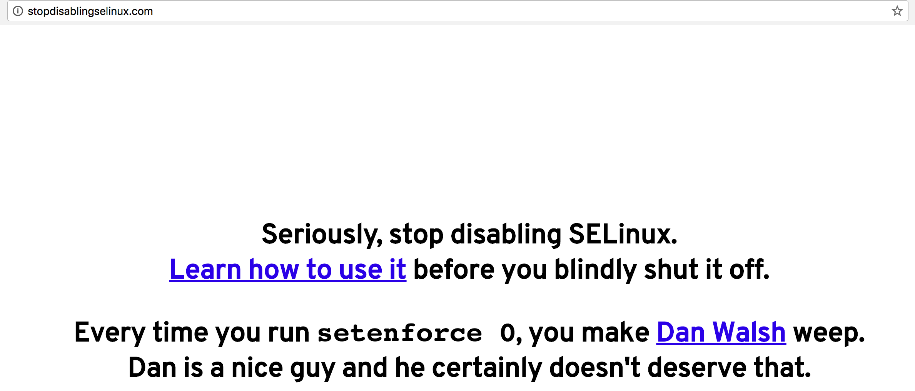

Zabbix Monitoring Tool Overview
Key points on installation on Centos 7:
extra PHP plugins need to be installed;
optional repository needs to be enabled (rhel-7-server-optional-rpms);
for Zabbix server and proxy daemons a database is required.
SELinux has to be disabled or properly configured :)
there can only be one Zabbix server, the load is reduced with use of proxy servers
two types of logs files: history and trends
Presentation created by Iryna Diudiuk
Notes:
history keeps each collected value
trends keep averaged information on hourly basis and therefore are less resource-hungry.
older data will be removed by the housekeeper.

Slide 10
Zabbix Monitoring Tool Overview
Zabbix Server
is the core component of Zabbix software;
performs the polling and trapping of data, calculates triggers, sends notifications;
central repository for configuration, statistical and operational data;
components of Zabbix server are: server, web frontend and database storage;
it is designed to run as a non-root user;
can be installed only on UNIX like operating systems;
by default listens on port 10051
Presentation created by Iryna Diudiuk

Slide 11
Zabbix Monitoring Tool Overview
Zabbix Agent
gathers operational information locally and reports data to Zabbix server;
performs two types of checks:
passive - responds to a data request;
active - retrieves a list of items from ZS, and periodically sends the response.
uses two types of items 'Zabbix agent' or 'Zabbix agent (active)’.
parameters have to be configured in zabbix_agentd.conf:
Server - (e.g. 127.0.0.1)
Hostname - required for active checks, matches hostname in web interface
LogFile - required if it a file should be monitored
listens on port 10050
Presentation created by Iryna Diudiuk
Notes:
file - write log to file specified by LogFile parameter,
system - write log to syslog,
console - write log to standard output.
can execute remote commands system.run
starts not as a root by default

Slide 12
Zabbix Overview
Zabbix Proxy
collects performance and availability data on behalf of Zabbix server.
an optional part of Zabbix deployment;
beneficial to distribute the load of a single Zabbix server.
if Zabbix server and proxy are installed on the same host, their databases must be created with different names
vi /etc/zabbix/zabbix_proxy.conf DBHost=localhost DBName=zabbix DBUser=zabbix DBPassword=<password>
Presentation created by Iryna Diudiuk

Slide 13

Zabbix Monitoring Tool Overview
Zabbix Web Key Notions:
Item – gathers data as metrics from a host, uses keys and parameters system.cpu.load[avg5]
Visualizations:
graph - visual representation of info based on history and trends;
network maps - overview of your infrastructure;
screen - is a table that groups information from various sources for a quick overview
Trigger - expression that defines a threshold of what state of data is “acceptable”.
Template - set of entities for multiple hosts (items, triggers, graphs)
Event - discovery event, trigger event, auto registration events and internal events
Presentation created by Iryna Diudiuk
Notes:
graph - visualization of data gathered by items
All users in Zabbix (including non-admin users) can create screens. Screens have an owner - the user who created them.
Screens can be made public or private. Public screens are visible to all users.
screen= simple graphs +network map, system status, data overview, clock, history of events, history of recent actions;
For both public and private screens a user must have at least read permissions to all screen elements in order to see the screen. To add an element to a screen a user must also have at least read permission to it.

Slide 14
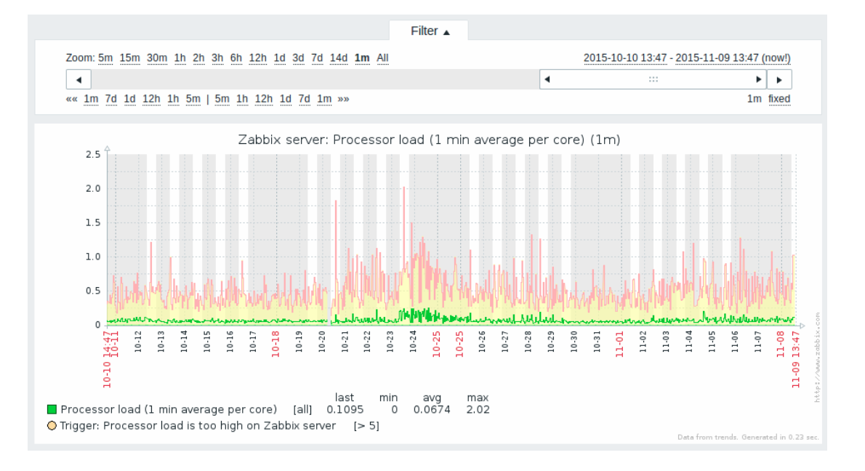
Zabbix Monitoring Tool Overview
Graph view —>
Presentation created by Iryna Diudiuk
Notes:
graph - visualization of data gathered by items

Slide 15
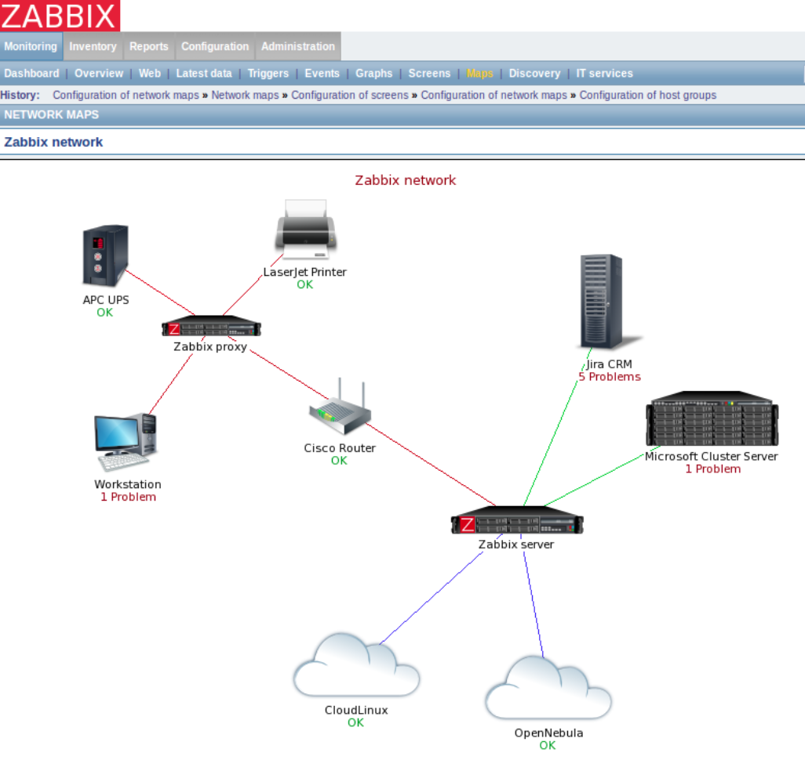
Zabbix Monitoring Tool Overview
Network Map view —>
Notes:
graph - visualization of data gathered by items

Slide 16
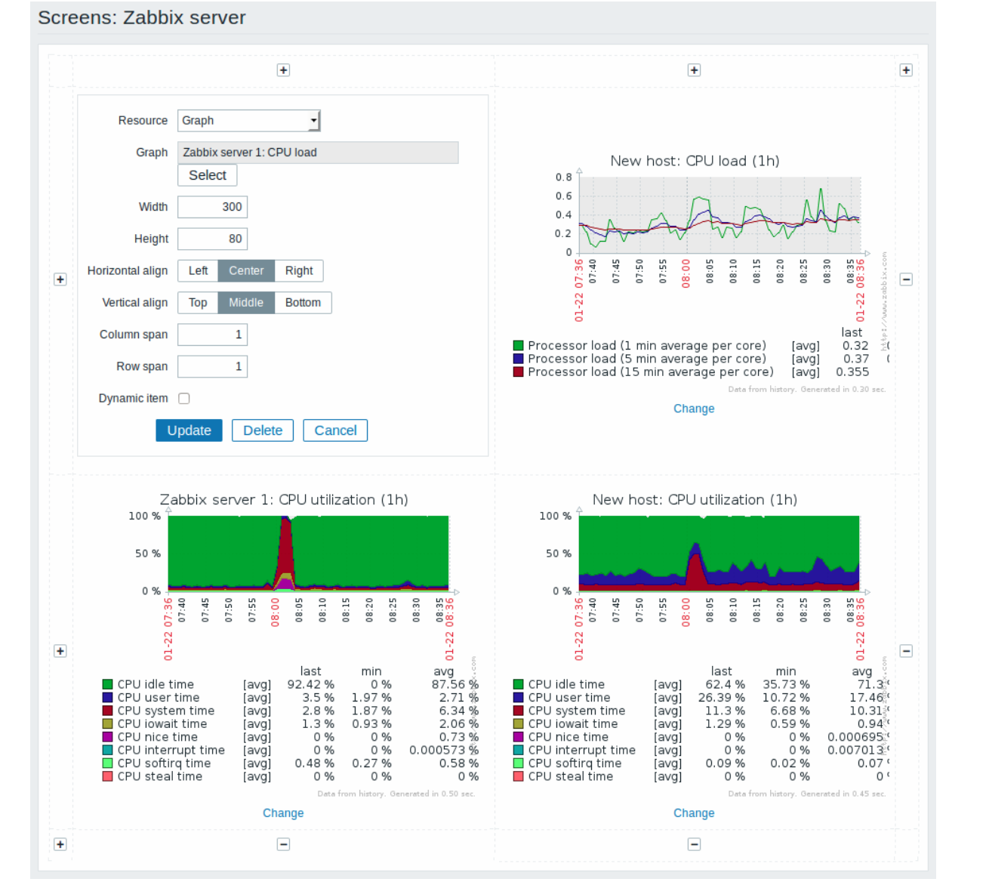
Zabbix Monitoring Tool Overview
Screen view —>
Notes:
graph - visualization of data gathered by items

Slide 17
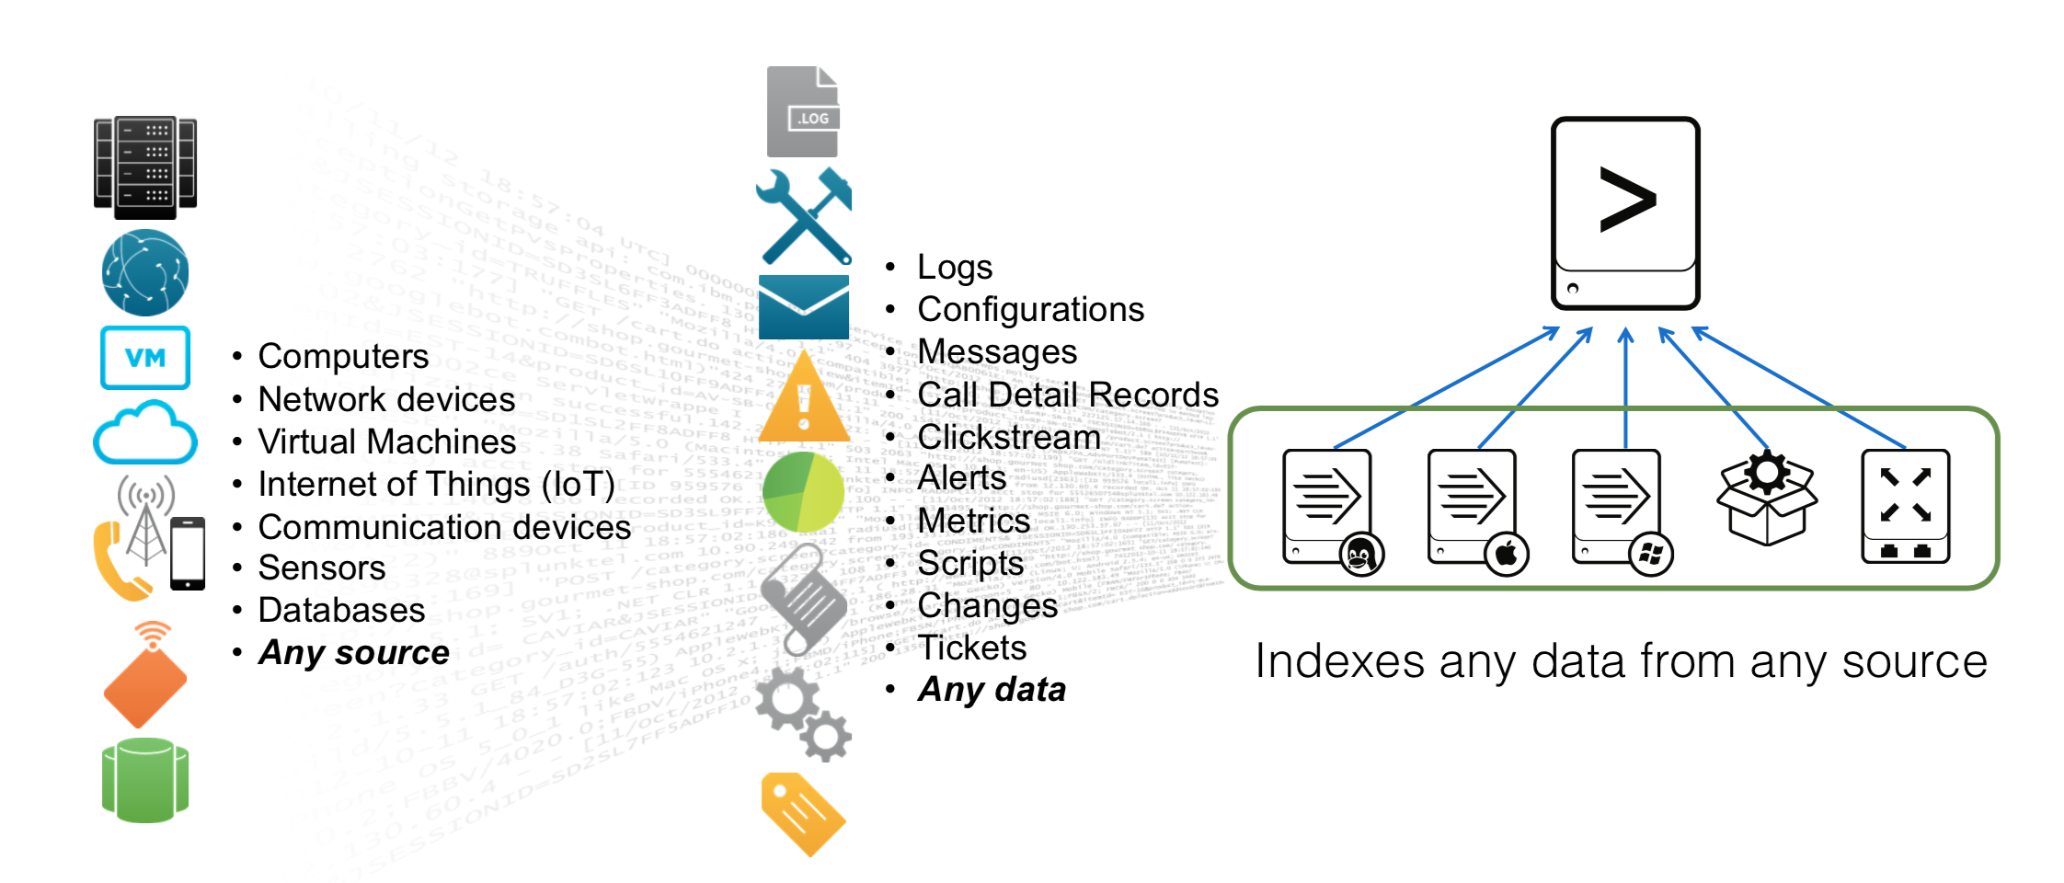
Splunk Overview
Splunk as log management tool
Splunk architecture
Concepts
Stages of App Development

Slide 18
Splunk Overview
is used to build solutions for various systems;
collects machine data from all kinds of sources;
works with Hadoop-based data, as well as data from relational databases;
uses various ways to get inputs (modular, scripted inputs, agent based inputs);
has its own query language - SPL;
provides reporting, alerting and real-time dashboards based on saved searches
has different indexing options (unused storage can roll to Hadoop);
scales easily (horizontically and vertically)
Presentation created by Iryna Diudiuk
Notes:
2003
HTTP Event Collector (HEC pronounced H-E-C) is a new, robust, token-based JSON API for sending events to Splunk from anywhere without requiring a forwarder. HTTP Event Collector (HEC pronounced H-E-C) is a new, robust, token-based JSON API for sending events to Splunk from anywhere without requiring a forwarder.
With a variety of standard and custom input methods, Splunk software can ingest all kinds of data types and sources. File-based data can be sent via forwarders that reside directly on the data sources, while DevOps, IoT and other data can be directly ingested using the Event Collector API, or a TCP/UDP port. You can pull data from API-based sources using Modular Inputs and other methods. Common IT, security and application data sources can also be onboarded and analyzed directly with hundreds of free apps and add-ons.
140 analytical commands - Splunk Search Processing Language (SPL™)
Use scheduled searches to create the real-time dashboards and visualizations that keep the team and management informed.
Splunk software supports SAML integration for single sign-on via most popular identity providers and comes pre-configured for a growing number of providers like Okta, PingFederate, Azure AD, CA SiteMinder, OneLogin and Optimal IdM. Splunk can also integrate with other authentication systems, including LDAP, Active Directory and e-Directory, and supports integration with Duo two-factor authentication.
You can keep historical data within Splunk and reduce the data footprint of seldom-analyzed, cold data. Or, you can roll your data to an existing Hadoop or Amazon Simple Storage Service (Amazon S3) data lake.

Slide 19
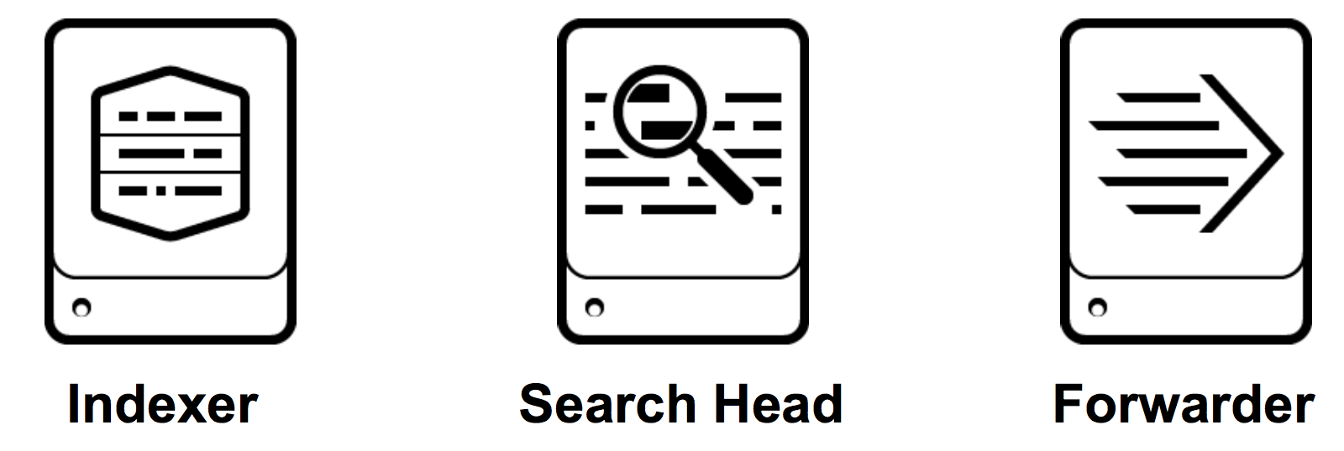
Splunk Overview
Splunk architecture
Data goes through the cycle —>
Key components of Splunk —>
Presentation created by Iryna Diudiuk

Slide 20
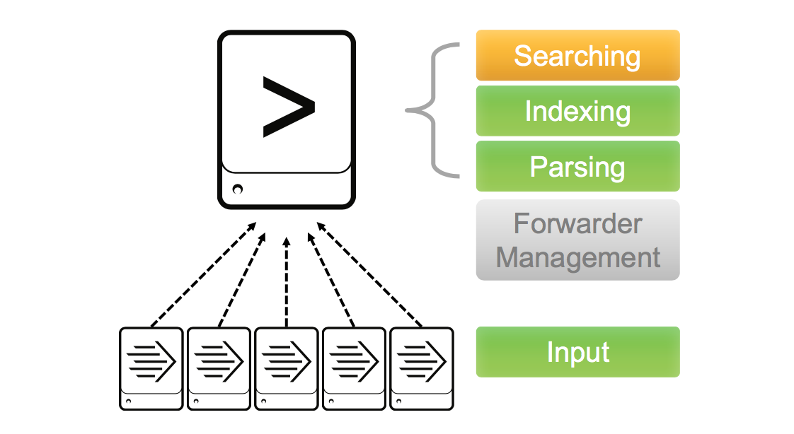
Splunk Overview
Simple architecture —>
Presentation created by Iryna Diudiuk

Slide 21
Splunk Overview
Distributed
deployment
architecture —>

Slide 22
Splunk Overview
Concepts:
index - repository for data in Splunk Enterprise. Resides in files on the Splunk Enterprise instance known as the indexer;
source - shows event origin;
sourcetype - determines how Splunk formats the data during the indexing process;
precendence - Splunk uses configuration files to determine aspects of its behavior;
app - offers user interfaces to work with your data, often uses additional add-ons;
add-on - enables Splunk app to ingest or map a particular type of data.
Presentation created by Iryna Diudiuk
Notes:
The repository for data in Splunk Enterprise. When Splunk Enterprise indexes raw event data, it transforms the data into searchable events. Indexes reside in flat files on the Splunk Enterprise instance known as the indexer.
In the case of data monitored from files and directories, the source consists of the full pathname of the file or directory. In the case of a network-based source, the source field consists of the protocol and port, such as UDP:514. Each event has a source field. The indexer generates the source field at index time. Searches often use the source as a criterion.
Splunk Enterprise comes with a large set of predefined source types, and it assigns a source type to your data. You can override this assignment by assigning an existing source type or creating a custom source type.
The indexer identifies and adds the source type field when it indexes the data. As a result, each indexed event has a sourcetype field.
Three important default fields are host, source, and source type, which describe where the event originated.
A Splunk platform deployment can have many copies of the same configuration file. These file copies are usually layered in directories that affect either the users, an app, or the system as a whole.
• App or user: Some activities, like searching, take place in an app or user context. The app and user context is vital to search-time processing, where certain knowledge objects or actions might be valid only for specific users in specific apps.
• Global: Activities like indexing take place in a global context. They are independent of any app or user. For example, configuration files that determine monitoring behavior occur outside of the app and user context and are global in nature.
Apps generally offer extensive user interfaces that enable you to work with your data, and they often make use of one or more add-ons to ingest different types of data. Add-ons generally enable the Splunk platform or a Splunk app to ingest or map a particular type of data.

Slide 23
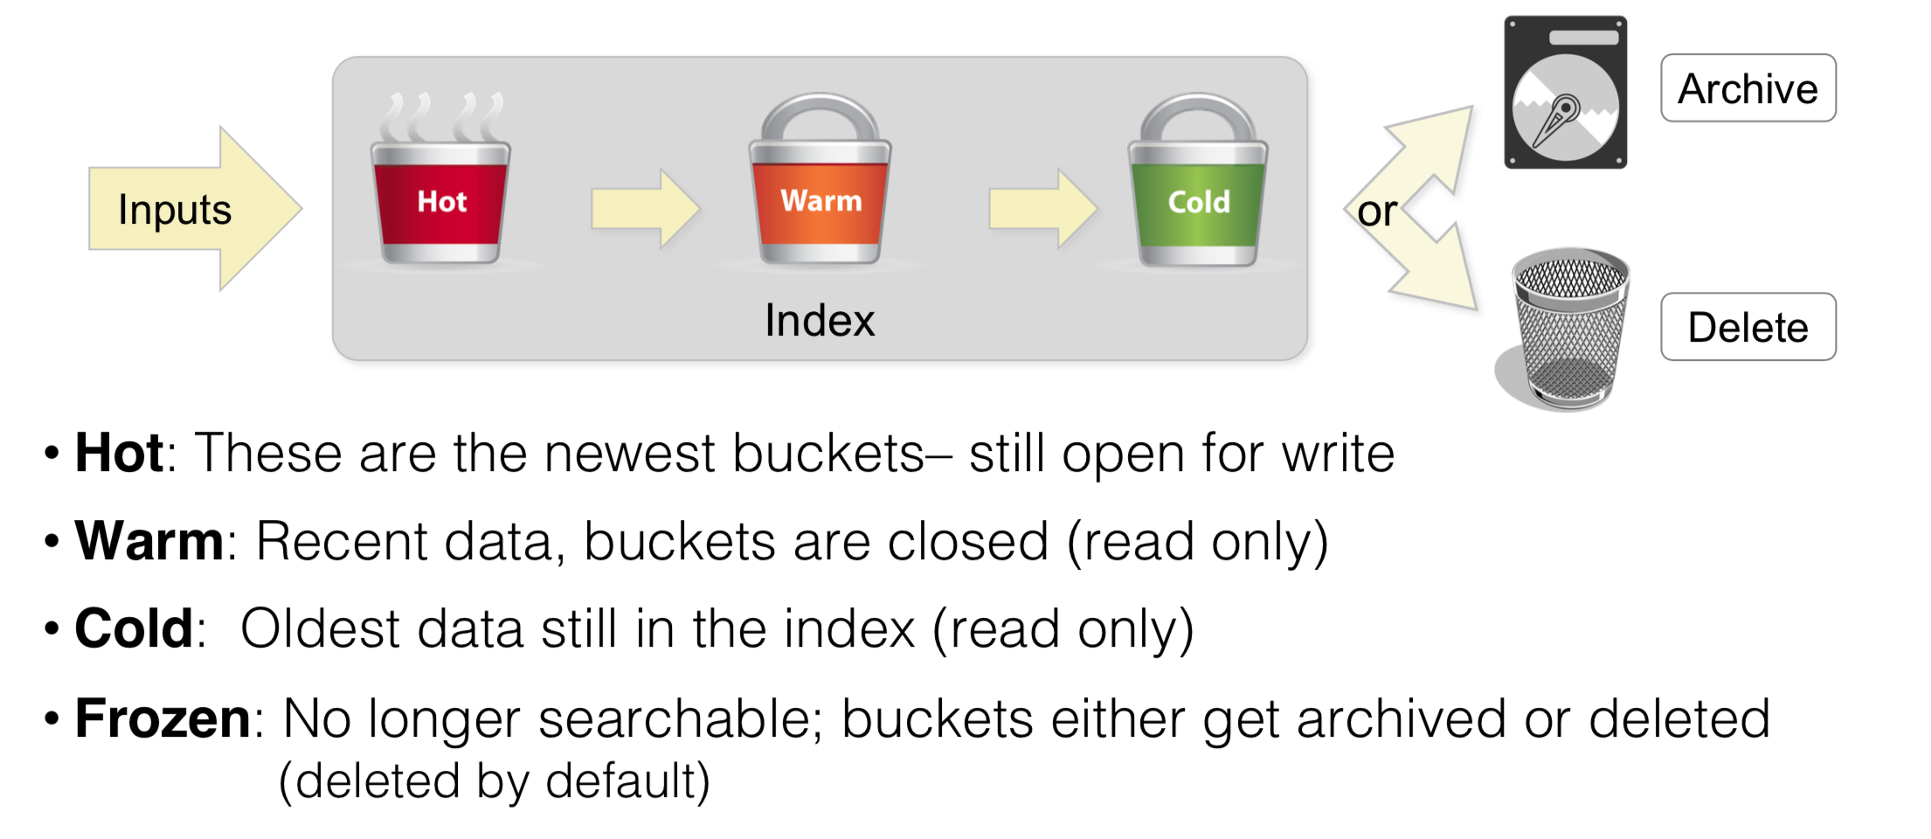
Splunk Overview
Index Buckets:
Notes:
timestamp - on the indexing stage or in the file
When you add data, the indexer processes it and stores it in an index. By default, data you feed to an indexer is stored in the main index, but you can create and specify other indexes for different data inputs.
An index is a collection of directories and files. These are located under $SPLUNK_HOME/var/lib/splunk.

Slide 24
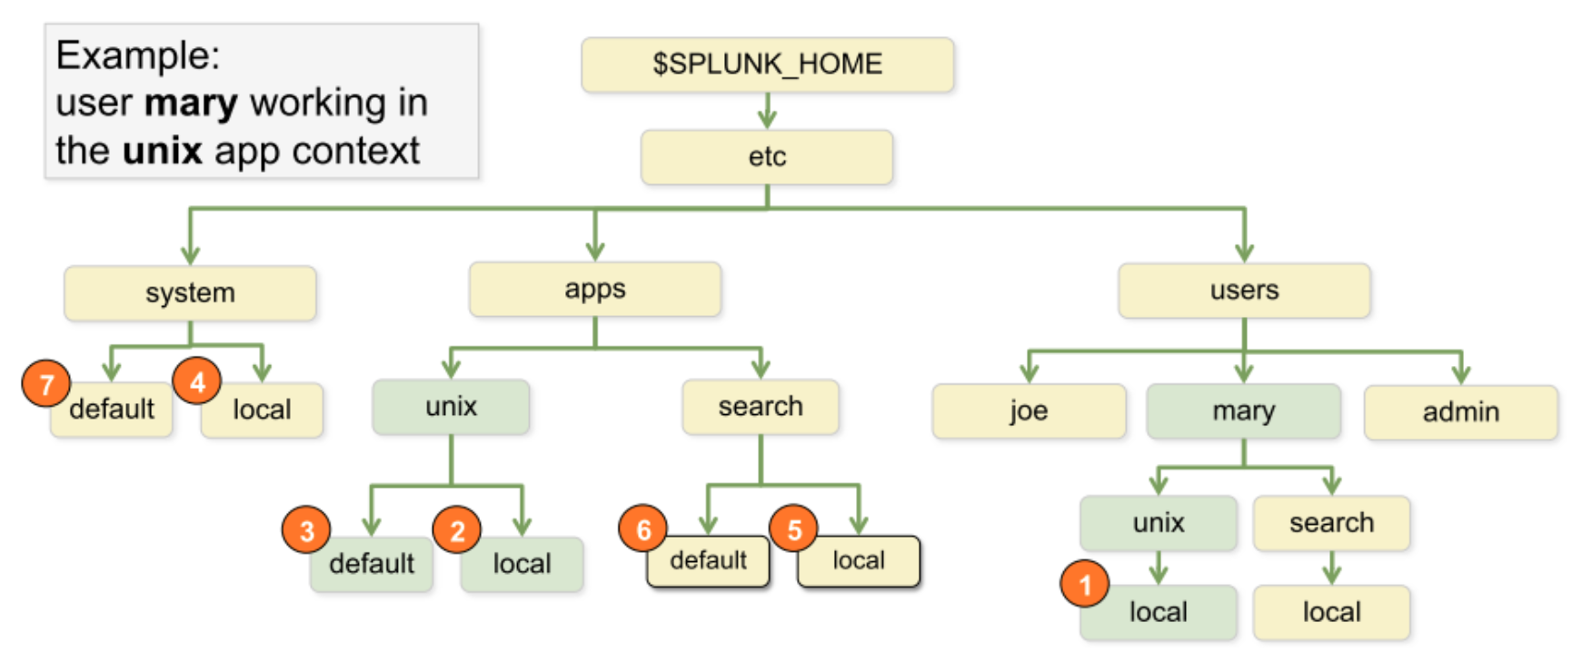
Splunk Overview
Precedence:
Notes:
The repository for data in Splunk Enterprise. When Splunk Enterprise indexes raw event data, it transforms the data into searchable events. Indexes reside in flat files on the Splunk Enterprise instance known as the indexer.
only changes are saved in local

Slide 25
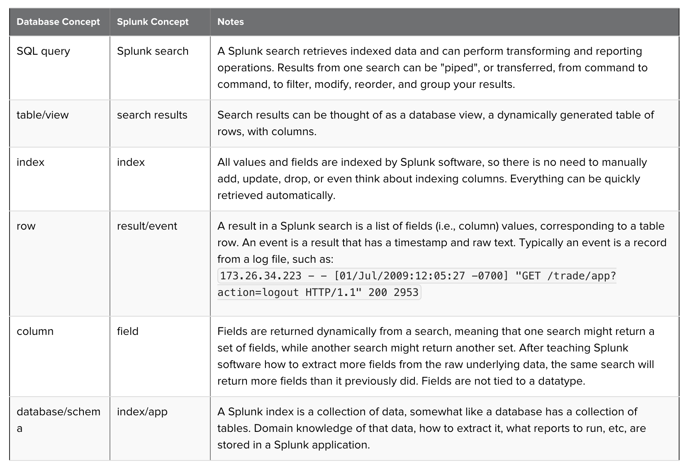
Splunk Overview
SPL and SQL:
Notes:
The repository for data in Splunk Enterprise. When Splunk Enterprise indexes raw event data, it transforms the data into searchable events. Indexes reside in flat files on the Splunk Enterprise instance known as the indexer.
only changes are saved in local

Slide 26
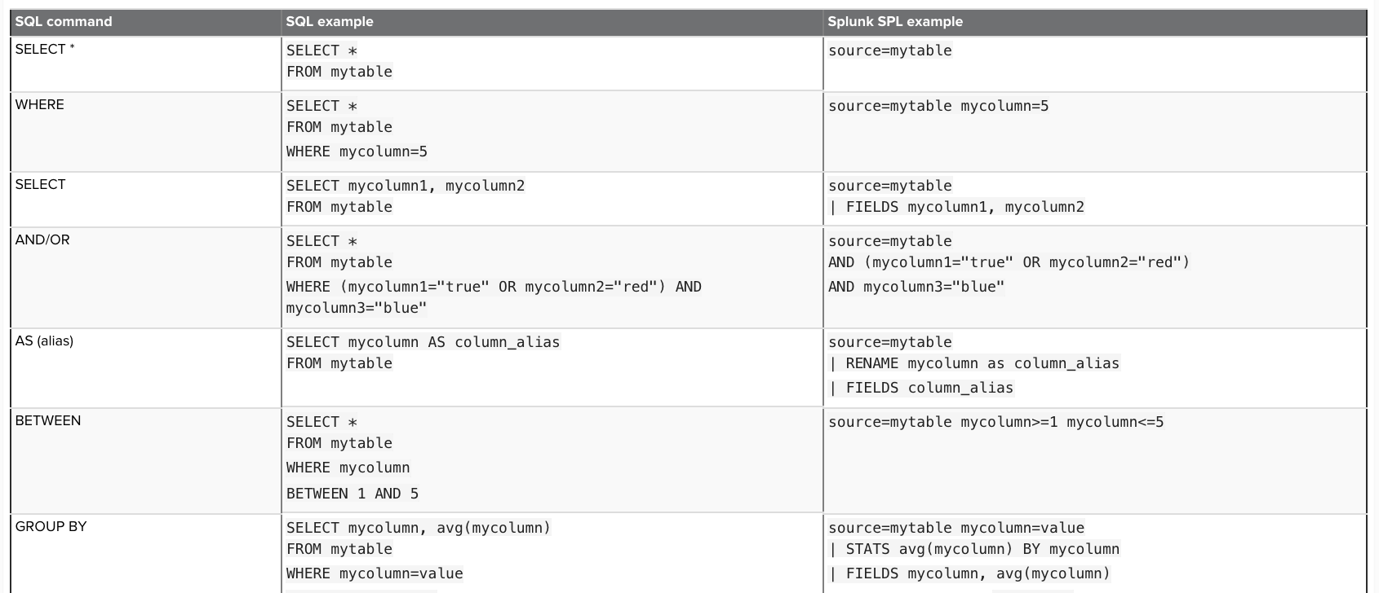
Splunk Overview
SPL and SQL:
Notes:
The repository for data in Splunk Enterprise. When Splunk Enterprise indexes raw event data, it transforms the data into searchable events. Indexes reside in flat files on the Splunk Enterprise instance known as the indexer.
only changes are saved in local

Slide 27

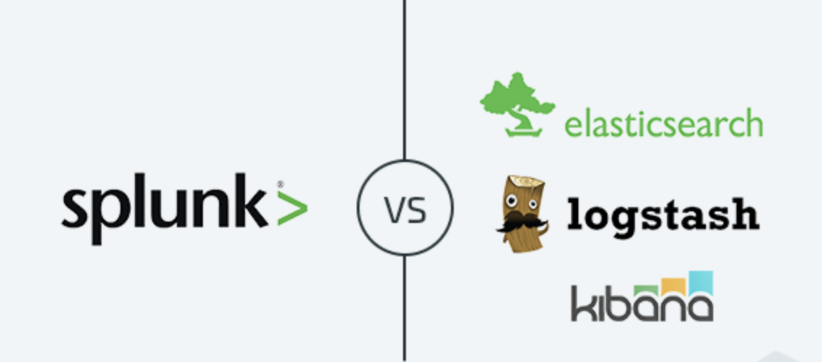
Splunk Overview
Splunk vs ELK:
Notes:
The repository for data in Splunk Enterprise. When Splunk Enterprise indexes raw event data, it transforms the data into searchable events. Indexes reside in flat files on the Splunk Enterprise instance known as the indexer.
only changes are saved in local

Slide 28
Splunk Overview
End of theory…time for practice:
The instructions are in Task file following the link:
https://goo.gl/huF73s
Notes:
The repository for data in Splunk Enterprise. When Splunk Enterprise indexes raw event data, it transforms the data into searchable events. Indexes reside in flat files on the Splunk Enterprise instance known as the indexer.

Slide 29
Resources
https://www.infoworld.com/article/2625977/security-management/living-the-log-management-lifecycle.html
https://www.zabbix.com/documentation/3.4/manual/appendix/items/activepassive#active_checks
https://splunkbase.splunk.com
https://answers.splunk.com
http://docs.splunk.com/
Presentation created by Iryna Diudiuk

